Slide 1


SAPTHAGIRI COLLEGE OF ENGINEERING
(Affiliated to Visvesvaraya Technological University, Belagavi & Approved by AICTE, New Dehli)
Recognized by AICTE, New Delhi & Affiliated to VTU, Belagavi) An ISO 9001:2015 & 14001:2015certifiedinstitutionAccredited by NAAC with ‘A’ grade Accredited by NBA 14/5, Chikkasandra, Hesaraghatta Main Road, Bengaluru – 560 057. Department of Information Science & Engineering
INTERNSHIP PRESENTATION (18CSI85)
ON
“HEART FAILURE PREDICTION USING KNN ALGORITHM”
Presented by:
S Kaushal 1SG19IS087
Under the guidance of:
Prof. Swetha K B
Assistant Professor,
Dept. of I.S.E., S.C.E.
2022-23

Slide 2
CONTENTS
1. INTRODUCTION ABOUT THE COMPANY
2. OVERVIEW OF THE ORGANIZATION
3. TASKS PERFORMED
3.1. LEARNING EXPERIENCE
3.2. KNOWLEDGE ACQUIRED
3.3. SKILLS LEARNED
3.4. THE MOST CHALLENGING TASK PERFORMED
3.5. PROBLEM IDENTIFICATION
4. REFLECTION
5. CONCLUSION

Slide 3

1. INTRODUCTION ABOUT THE COMPANY Karunadu Technologies Private Limited
Karunadu Technologies Private Limited is a leading IT software solutions and services industry.
The company offers broad range of customized software applications powered by concrete technology and industry expertise.
It also offers end to end embedded solutions and services. They deal with wide range of product development along with customized features ensuring at most customer satisfaction .
It is also a leading skills and talent development company that is building a manpower pool for global industry requirements.
They provide assistance to individuals for their IEEE academic project. They have a large collection of projects on latest technologies.

Slide 4
2. OVERVIEW OF THE ORGANIZATION
.
2.1. IT SOLUTIONS AND SERVICES
Karunadu Technologies is IT training and software development center with an exclusive expertise in the area of IT services and solutions.
It also expertise in web designing and consulting services.
2.2. EMBEDDED DESIGN AND DEVELOPMENT
Karunadu Technologies Pvt. Ltd. has expertise in Design and development of embedded products and offers solutions and services in field of Electronics.
2.3. SOFTWARE COURSES
Karunadu Technologies Pvt. Ltd. provides courses for students according to the interest of students keeping in mind the current technology and assist them for their further employment.
Company provides various courses.

Slide 5
3. TASKS PERFORMED 3.1.LEARNING EXPERIENCE
The objective of this internship is to apply theoretical knowledge of “Machine Learning using Python” to solve real time problem solving skills in order to achieve these basic concepts learnt based on Python and Machine learning and its implementation.
This internship helped us to learn the fundamental concepts of Artificial Intelligence and Machine Learning applications to different datasets and predict the results.
They made us work on projects with real-world applications in the Machine Learning Domain and gave a hands on experience with many tools
After the training period, I started working on the project “Heart Failure Predition Using KNN algoithm”

Slide 6
3.2.KNOWLEDGE ACQUIRED
About pyqt5 creating a graphical user interfaces (GUI) in python.
Basic knowledge about the widgets been used.
Creating a simple pyqt5 application.
Designing a GUI and Qt designer how to use a Qt designer a visual tool for designing GUI and python.
About Jupyter Notebook how it can be used to write and execute Python code.
Knowledge about jupyter notebook as it supports interactive data visualizations.
Learnt libraries like Numpy and Pandas.
Using pyqt5 and jupyter notebook to create interactive GUIs.
Demonstrated this by creating simple application that allow users to input data and view results.

Slide 7
3.3.SKILLS LEARNED
Basics of Python
Like conditional statements, loop statements,
Basics of PyQt5
Widgets,buttons ,apllication design
Machine Learning basic concepts
supervised learning
unsuprised learning
reinforcement learning
KNN algorithm
Data cleaning

Slide 8
3.4.THE MOST CHALLENGING TASK PERFORMED
Various activities were conducted during the internship training program which was very challenging. Activities provided the grounds for new ideas, and it also stimulated our creative and problem-solving skills.
One of the most challenging tasks that a machine learning intern may perform is developing and implementing a machine learning model to solve a real-world problem. This involves not only choosing an appropriate algorithm and optimizing its parameters, but also dealing with the complexities of real-world data and ensuring that the model is accurate and generalizes well to new data.
Integrating and debugging the model pyqt5 with other libraries in jupyter was challenging.
Throughout the program, we gained valuable experience in using both Pyqt5 and Jupyter Notebook.
Cleaning and preprocessing data requires a careful understanding of the data and the problem at hand, as well as the ability to use a variety of tools and techniques to manipulate and transform the data

Slide 9
3.5. PROBLEM IDENTIFICATION
Objective : Heart failure prediction is a critical task in healthcare that can help identify individuals who are at high risk for developing heart failure. The aim is to develop a K-nearest neighbors (KNN) algorithm model for predicting heart failure in patients based on their clinical data .
By analyzing a clinical dataset, it is possible to predict whether a patient has a healthy heart function or is at risk of heart failure. This analysis can provide valuable information for healthcare professionals to make informed decisions about the patient's treatment.
Software used: Jupyter notebook,Pyqt5
Algorithm used: K-nearest neighbors (KNN) Algorithm: It is a supervised machine learning algorithm used for classification and regression tasks and predicts the value of a new data point based on the labels of its K nearest neighbors in the training set.

Slide 10
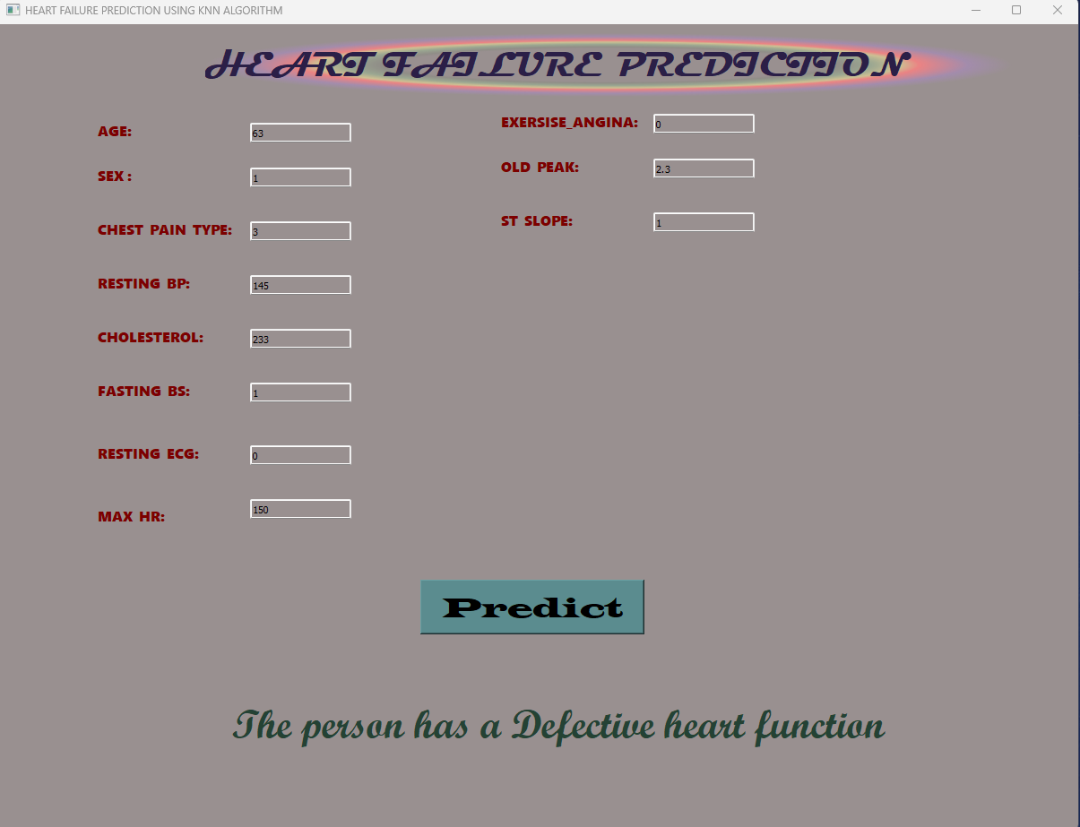
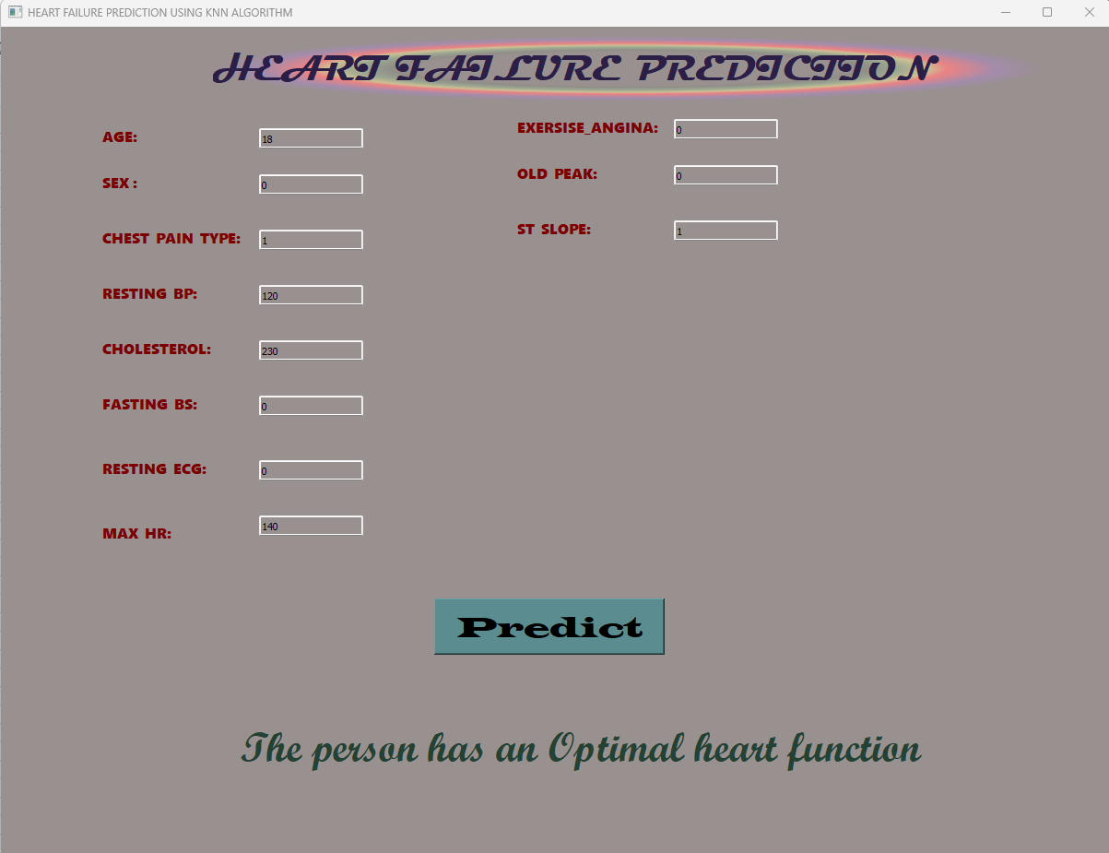
4.REFLECTIONS
(fig 1:- prediction of an unhealthy heart condition) (fig2:-prediction for healthy heart condition )

Slide 11
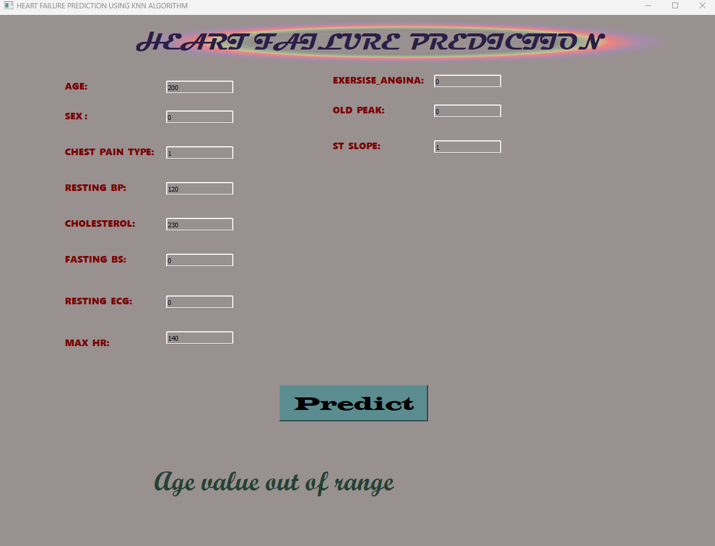
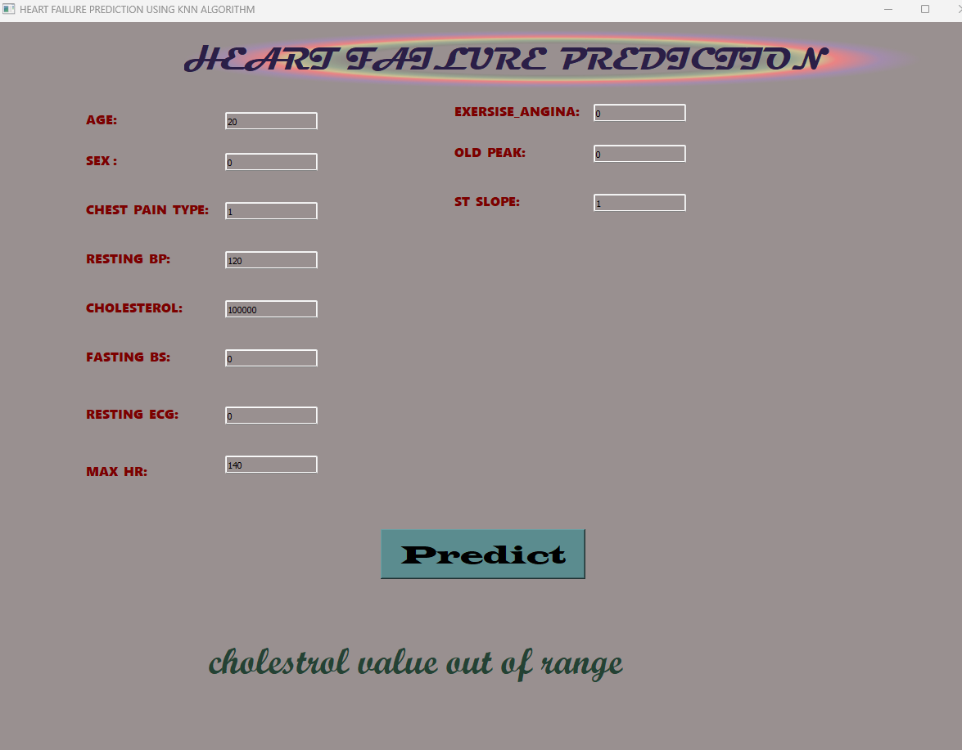
4.REFLECTIONS CONT.
(fig 3:- Age value out of range entered by user) (fig4:- Cholesterol value out of range entered by user)

Slide 12
5.CONCLUSION
In conclusion, a machine learning internship can be an excellent opportunity to gain practical experience and learn valuable skills in the field of machine learning.Through real-world projects and collaboration with experienced mentors can develop our technical skills in data pre-processing, model development, python libraries and Pyqt5
Overall, a machine learning internship can provide a solid foundation for a career in machine learning and related fields and helped to acquire knowledge about work culture of corporate IT Sector in India.

Slide 13
THANK YOU

